Slide 1
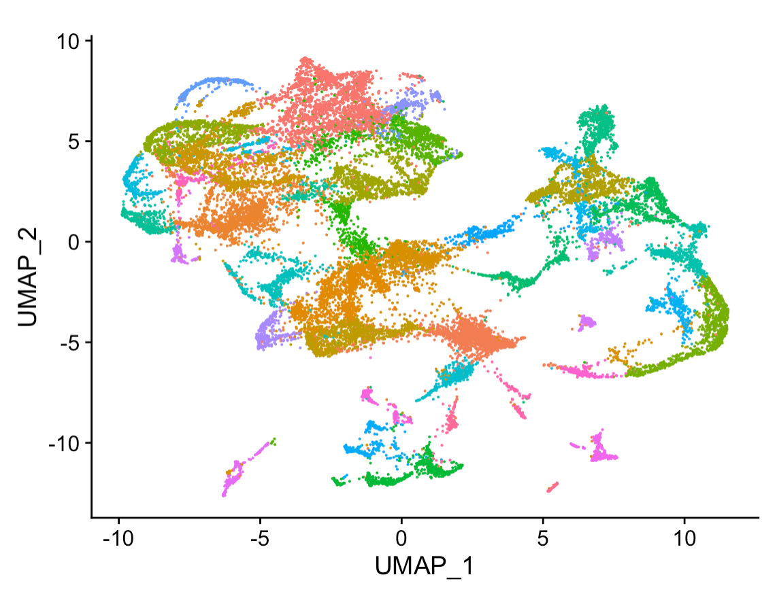
Picking the Right ML Algorithm
Data4ML
Summer 2022

Slide 2
It’s still all about data
There are lots of ML algorithms. What’s makes them different is how they perform on different datasets
What makes an algorithm ‘good’
Low bias, high accuracy
Able handle your input features (size and type)
How easy it is in interpret
How fast it learns

Slide 3
Structured Data - Methods

Slide 4
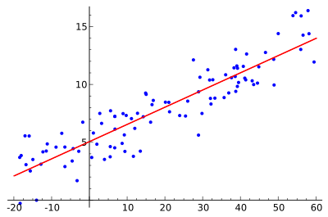
Model Parade – Linear Regression
Linear Regression
Assume the data can be represented by a line

Slide 5
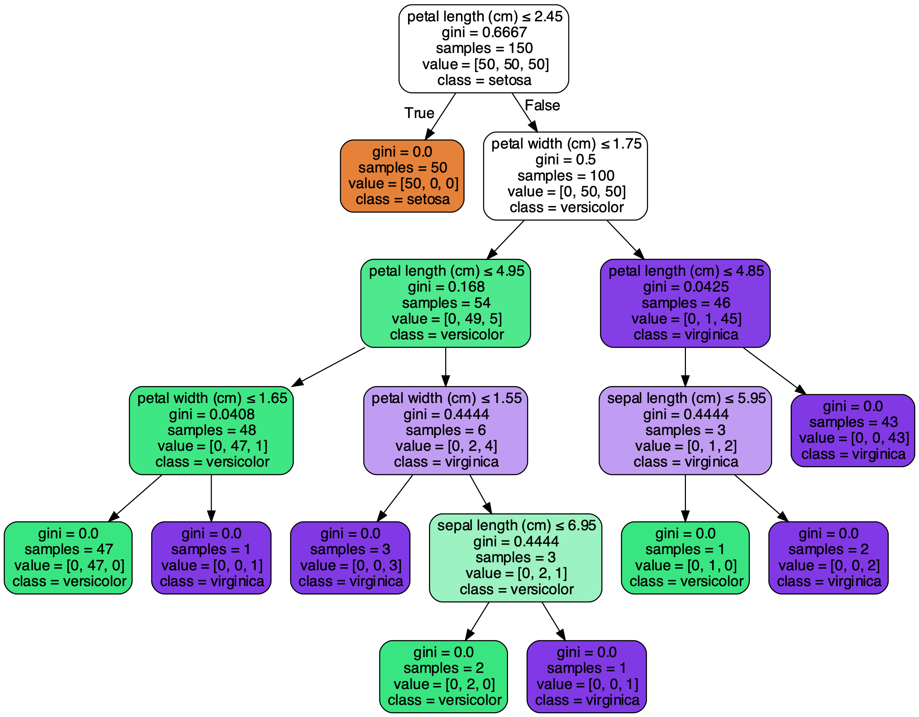

Model Parade – Random Forest
Decision Tree
Decision Forest

Slide 6
Model Parade – Random Forest
Each node is split to minimize the gini index ( p*(1-p) ) based on a simple cut on a variable.
Variables to cut on at each node are selected at random from all the variables normally three are used
Each tree uses a subset of the data
Robust to overfitting due to random sub-sampling
Good error estimates from Out of Bag samples (those not selected)
Importance can be used as an interpretation

Slide 7

Model Parade – Boosted Decision Tree
Same tree as a random forest, but focus is on accuracy
Data is not randomly sub-sampled
Trees in the forest are trained iteratively with data miss-classified by the previous tree ‘boosted’ so subsequent trees pay more attention to mistakes
Accuracy is better than a random forest on large datasets
Overfitting should be checked for

Slide 8
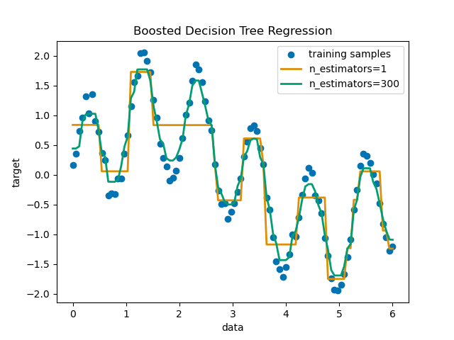
A Quick Note - Classification vs. Regression
Most or all ML techniques can be used for both:
Classification – targets are discrete labels
Regression – targets are continuous outputs
There are generally some modification that need to be make
Linear regression becomes Logistic regression
A Decision Tree becomes a Regression tree
Sometimes you’ll need to run a different function or specify in the arguments. Sometimes the packages will figure this out for you
https://scikit-learn.org/stable/auto_examples/ensemble/plot_adaboost_regression.html

Slide 9
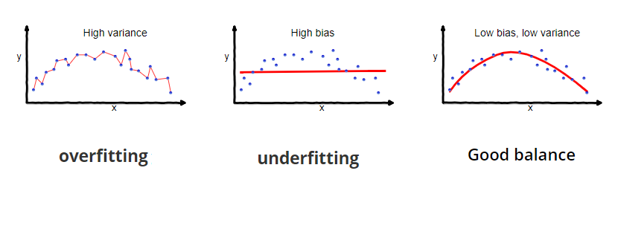
Bias Variance Tradeoff
https://towardsdatascience.com/understanding-the-bias-variance-tradeoff-165e6942b229

Slide 10

Neural Networks
A bit tricker to work with than decision tree
Need to be careful about data normalization
Training may not actually be better than a boosted decision tree
Why use them?
Offers tremendous flexibility
Can use any differential loss function
Has excellent performance if tuned

Slide 11
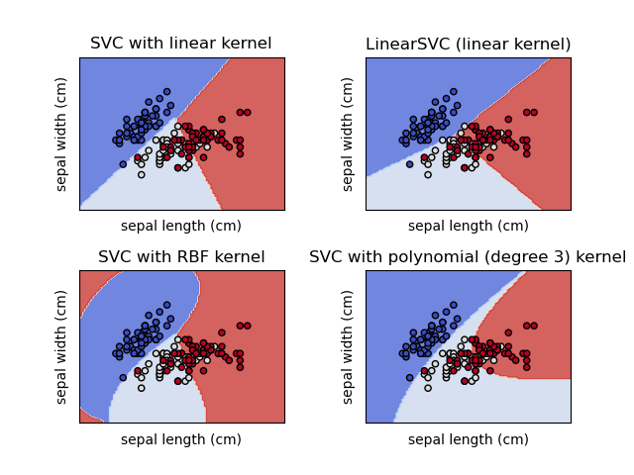
Support Vector Machines
The advantages of support vector machines are:
Effective in high dimensional spaces.
Still effective in cases where number of dimensions is greater than the number of samples.
The disadvantages of support vector machines include:
If the number of features is much greater than the number of samples, avoid over-fitting in choosing Kernel functions and regularization term is crucial.
SVMs do not directly provide probability estimates, these are calculated using an expensive five-fold cross-validation (see Scores and probabilities, below).
https://scikit-learn.org/stable/modules/svm.html

Slide 12
Assumptions ’buy’ Data
Simple models like linear regression, assume your data can be fit to a line
You need comparatively little data to do this
But it your dataset isn’t linear you can end up with a high bias
If you use complicated models without a functional form assumption
You have to worry about overfitting
May need more data for good performance
In both cases extrapolating beyond your dataset relies on assumptions
In the linear case you assume your line continues
In the

Slide 13
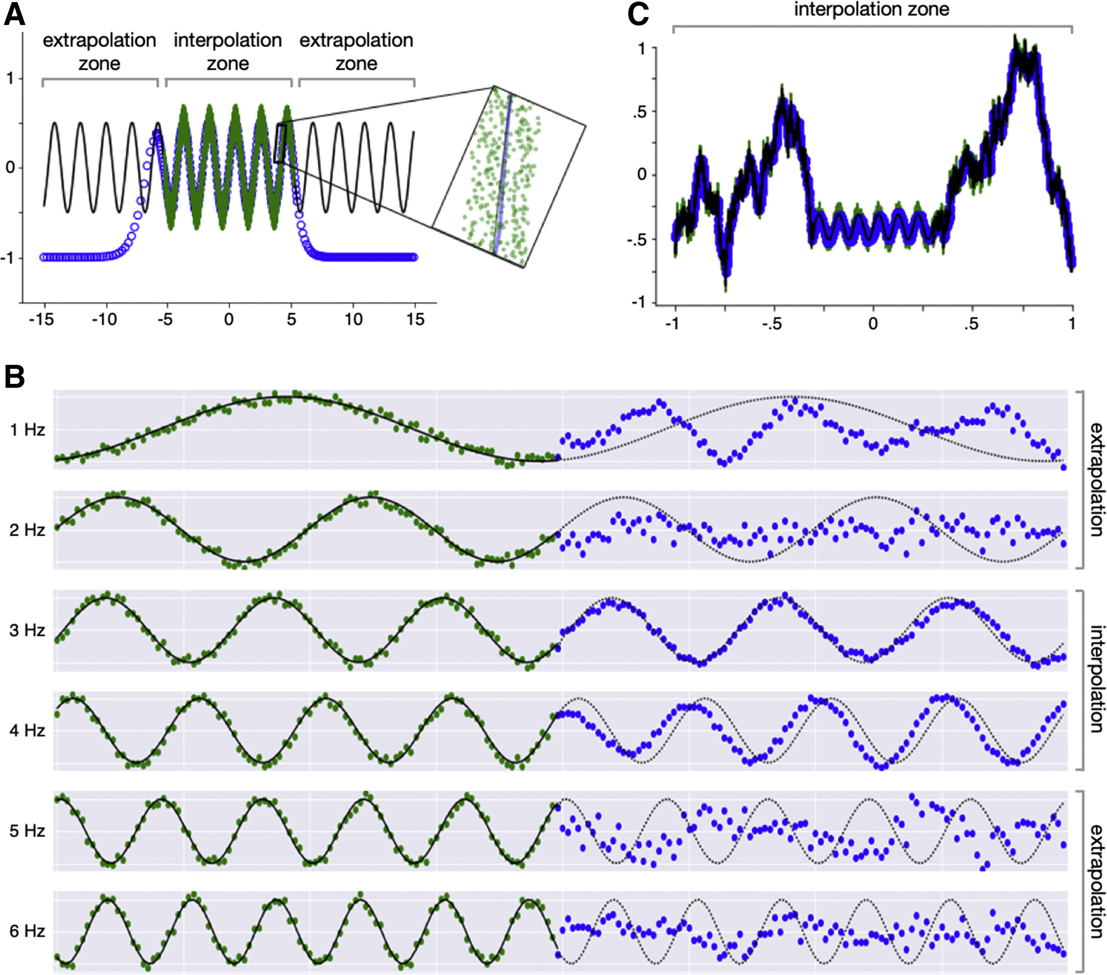
Extrapolation
ML does a lot of neat things, but it isn’t magic
Unless specified treat ML algorithms as universal function approximators
i.e. ‘Linear’ regression is not a universal function approximator
If you’re collecting data make sure you collect ’representative’ samples

Slide 14
Unstructured Data
Unstructured Data is generally used to refer to anything that doesn’t easily fit into our normal rows are examples columns are variables data model
Images, text, sounds etc.
Two common ways of dealing with this data
Feature engineering: Writing methods to extract ‘structured data’
i.e. A Bag of words from text
Deep Learning

Slide 15

Deep Learning
Unlike the above algorithms Deep Learning doesn't neatly fit into an R packages
It’s better to think of it as a box of Lego blocks
Deep Neural networks are made up of layers
Layers exist for text, images, structured data, etc.
Allows for building and training custom models
This models are often made available

Slide 16
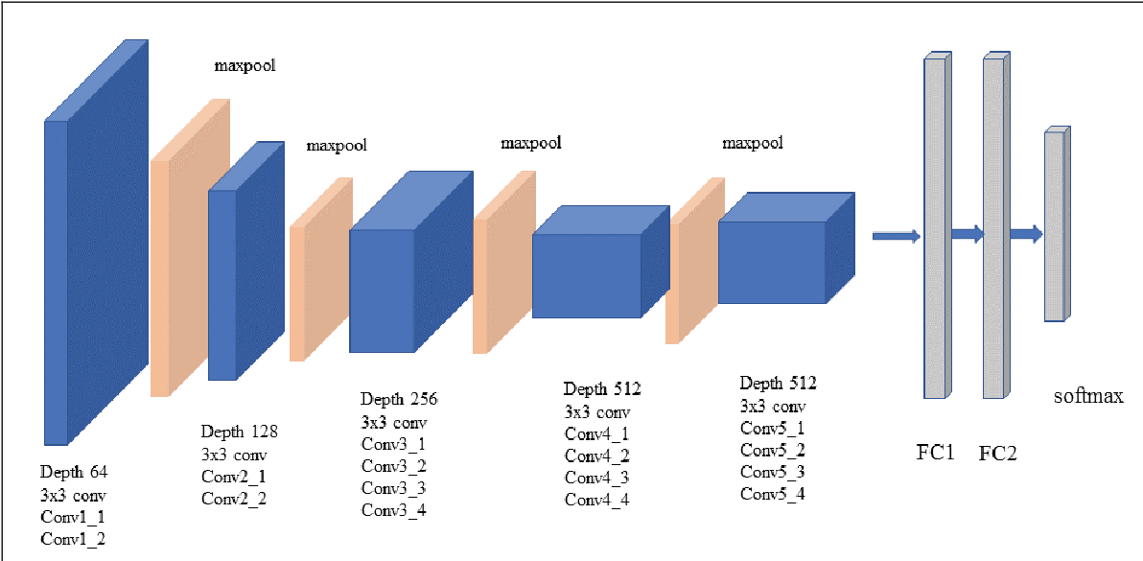
Example VGG 19 (Image Classification)

Slide 17
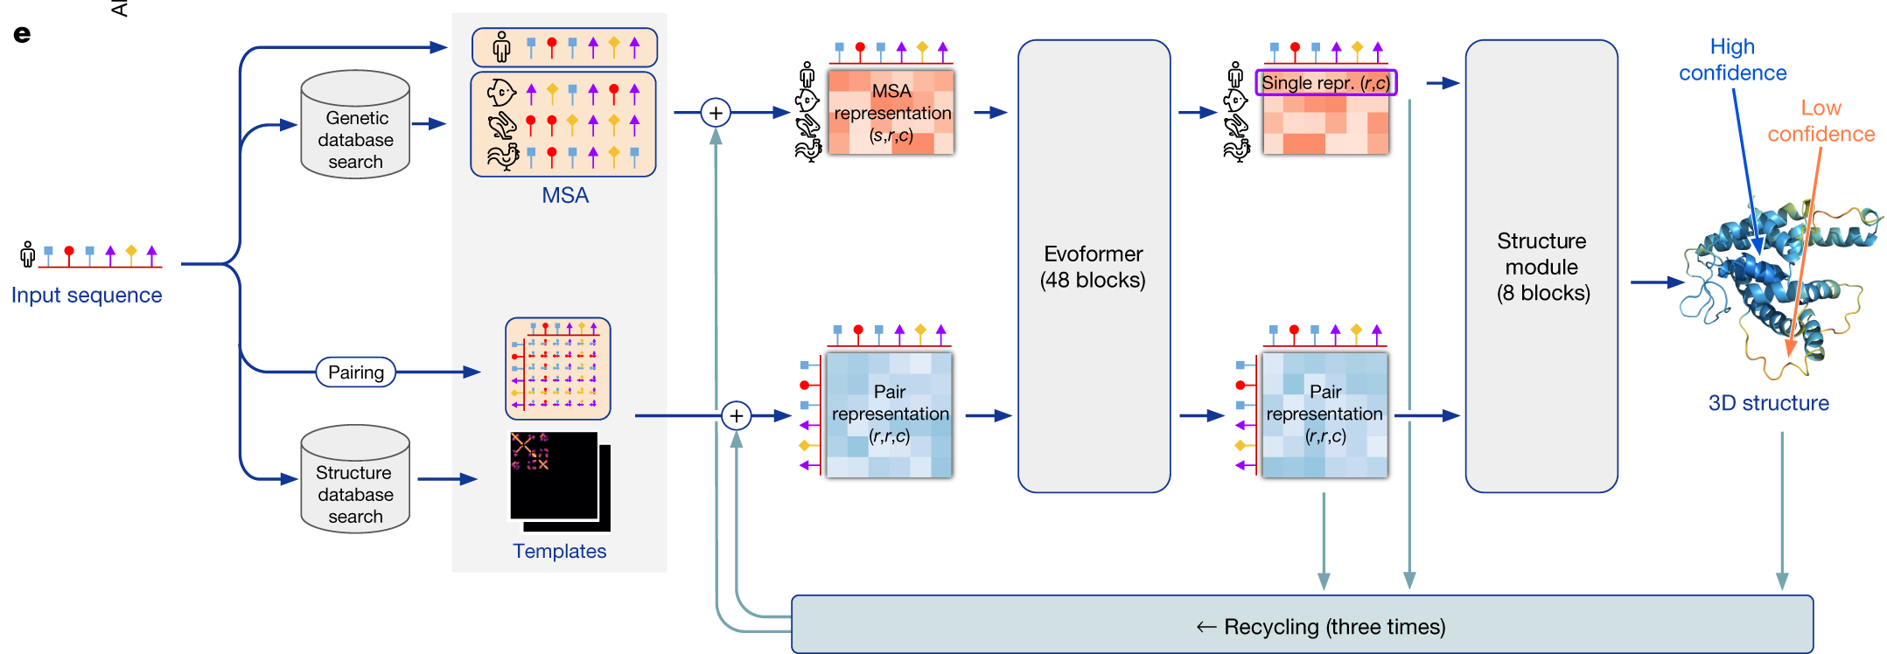
Example Alpha Fold (Protein Structure Prediction)

Slide 18
Evaluating Algorithms
I’m a big proponent of of evaluating models based on downstream goals
Are the predictions useful for my understanding
Is the model saving me time
Etc.
However, there is a lot of formal methods for evaluating the quality of predictions
Accuracy
Precision
Recall
F1
It’s worth asking yourself how good these need to be to meet your goal.

Slide 19
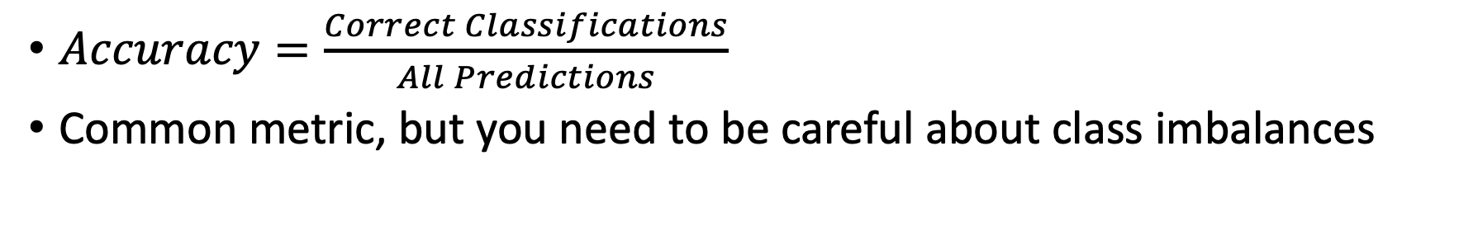
The Problem with Accuracy
$Accuracy=\frac{Correct Classifications}{All Predictions}$
Common metric, but you need to be careful about class imbalances
 | Prediction True | Prediction False
Class True | 90 | 0
Class False | 10 | 0
The above case guesses True for everything
It’s 90% accurate but isn’t very useful

Slide 20
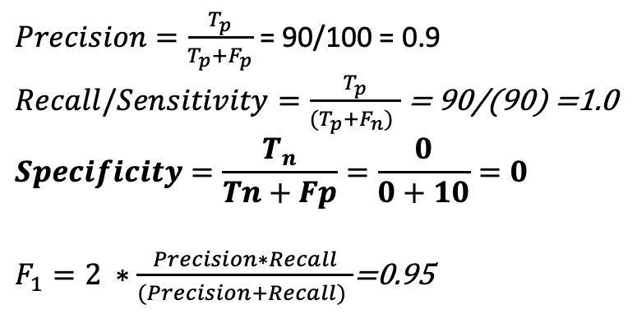
Other Metrics
 | Prediction True | Prediction False
Class True | True Positive | False Negative
Class False | False Positive | True Negative
$Precision=\frac{T_{p}}{T_{p}+F_{p}}$ = 90/100 = 0.9
$Recall/Sensitivity=\frac{T_{p}}{(T_{p}+F_{n}) }$ = 90/(90) =1.0
$$Specificity=\frac{T_{n}}{Tn+Fp}=\frac{0}{0+10}=0$$
$F_{1}=2 ∗\frac{Precision∗Recall}{(Precision+Recall) }$=0.95
 | Prediction A | Prediction B
Class A | 90 | 0
Class B | 10 | 0
Lots of metrics that go by lots of names
In this case specificity is a warning sign the model is broken/useless, but the others look okay, there are examples that go the other way as well
Recommendation make sure you check the performance on each of your classes and ask if it’s good enough for your goals

Slide 21
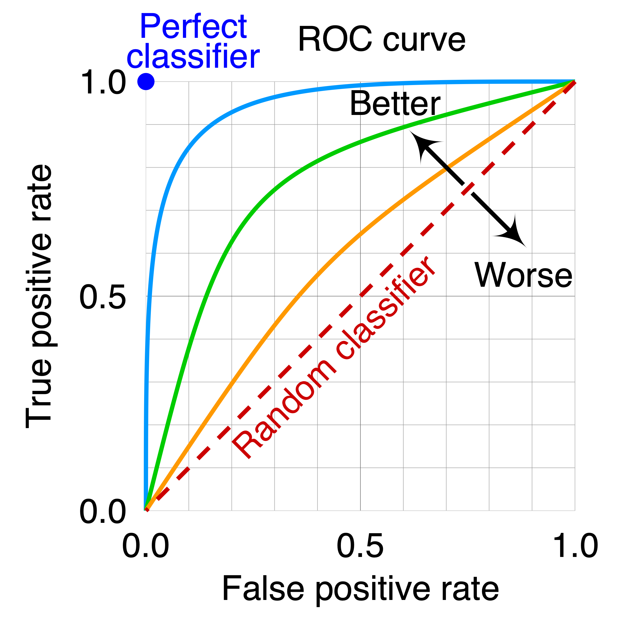
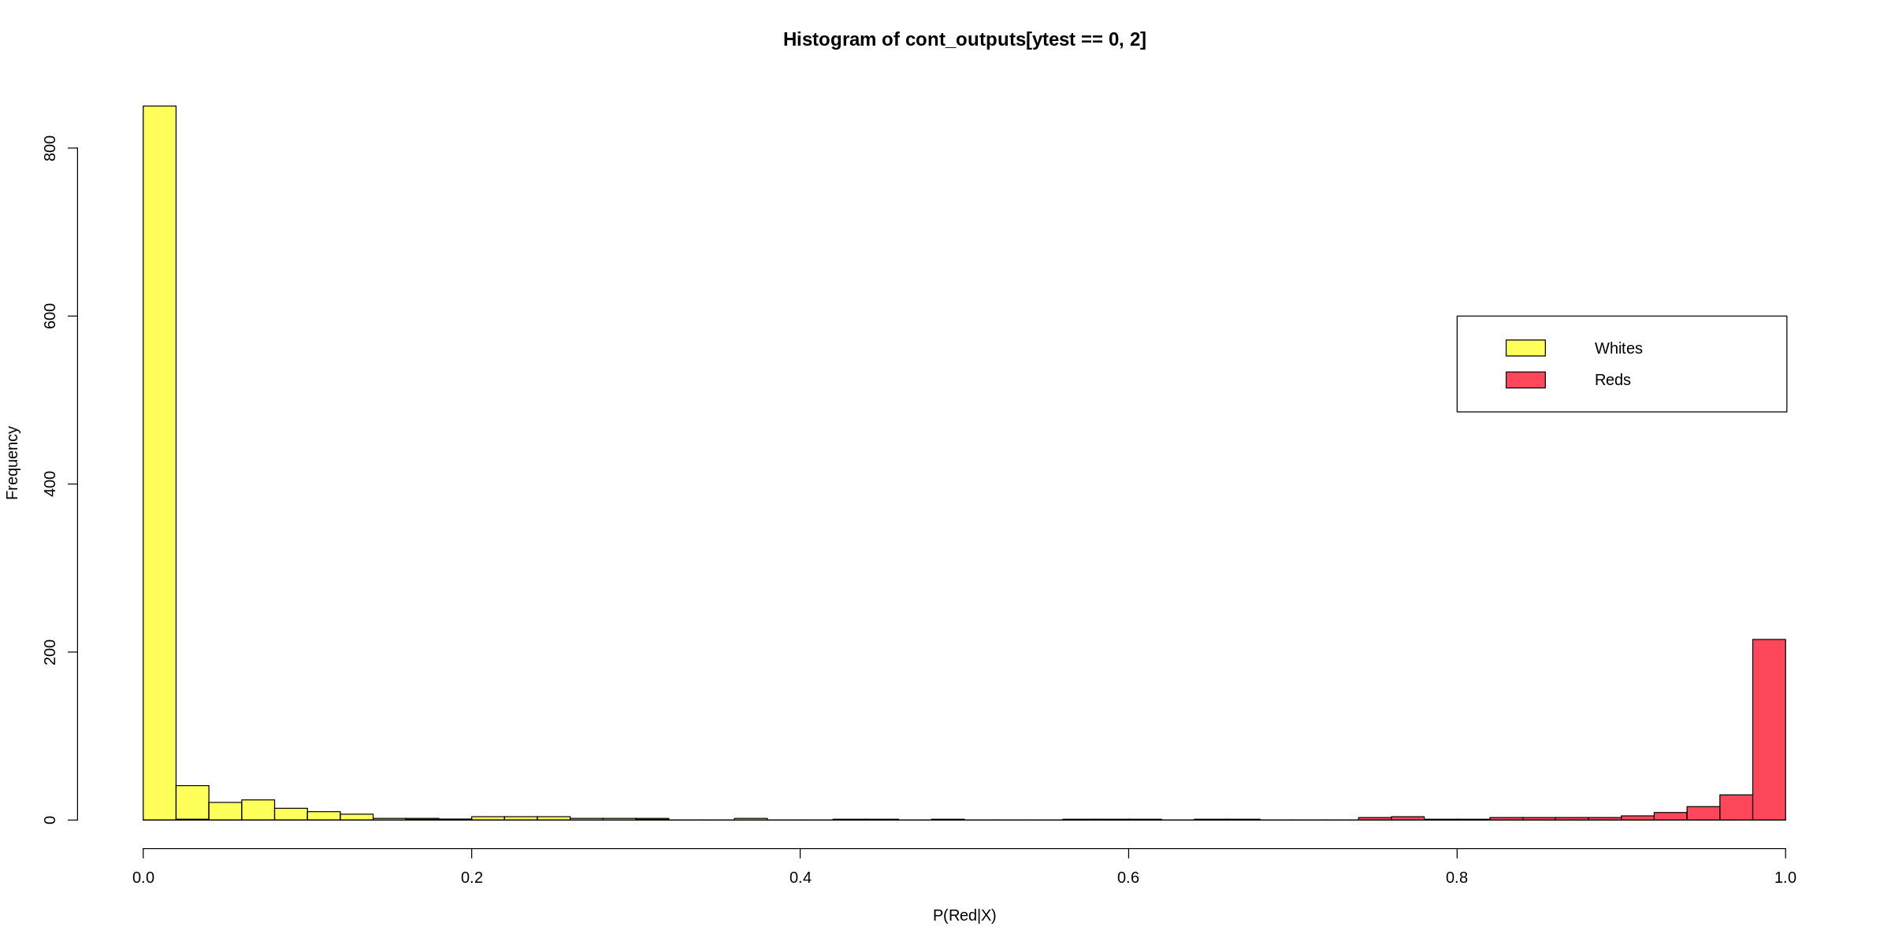
ROC Curves
It can be a bit more complicated as we often don’t just know the decision we can get a probability
By default most tools assume >0.5 is True, but it isn’t required
You can give this Receiver Operator Characteristic
AUC = Area under Curve with 1 being the best

Slide 22
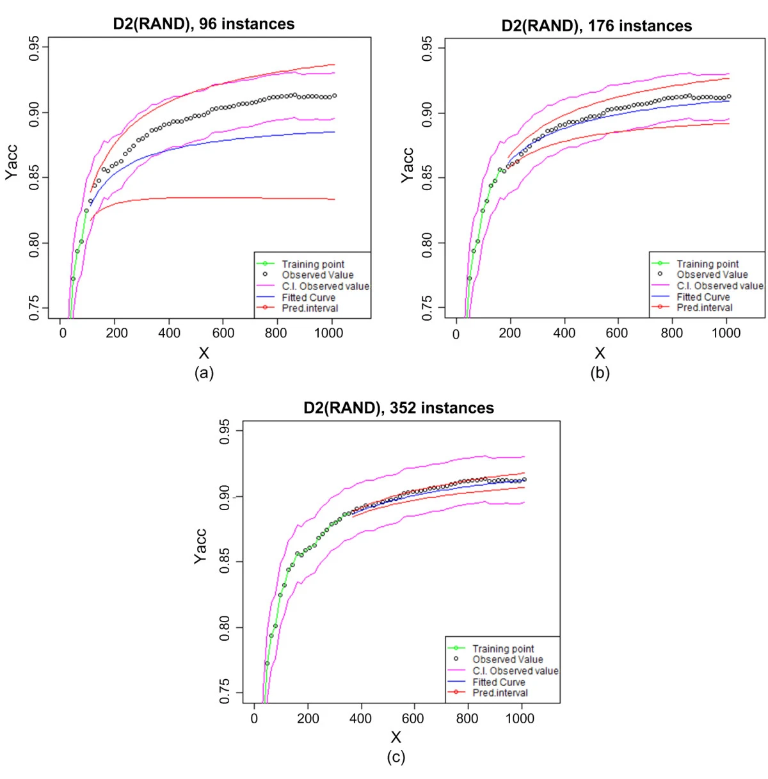
Learning Curves
Predicting sample size required for classification performance https://bmcmedinformdecismak.biomedcentral.com/articles/10.1186/1472-6947-12-8
You’ll need some data to estimate how much more you’ll need to reach a given accuracy
ML algorithms improve with data until they reach a saturation point
Can be useful to train models early in data taking to get an idea of how much more you’ll need to reach a certain goal

Slide 23
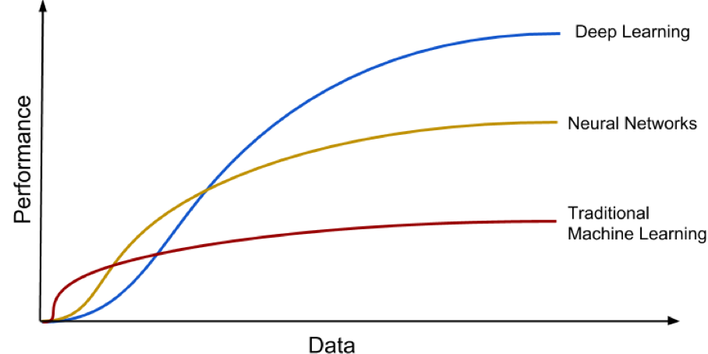
Models have different learning curves

Slide 24
Conclusions
Lots of available algorithms and lots of ways to evaluate them
Things to consider:
The kind of data you have
Structured vs. Unstructured
How much of it you have
Suggestion: Always keep your broader goals in mind when evaluating your models

